Slide 1


Social Buzz

Slide 2


Today's agenda
Project recap
Problem
Meet the Analytics team
Process
Insights
Summary

Slide 3

Social Buzz is a content-sharing platform with 500M+ monthly users, allowing reactions beyond traditional likes and comments. Daily, 100K+ pieces of content (text, images, videos, GIFs) are posted.
Lacking resources to manage their scale, they seek our third-party expertise to implement data best practices and support their IPO expansion next year.
To secure a long-term partnership, we are conducting a 3-month initial project to demonstrate our value. Social Buzz expects:
Big Data Audit to assess current practices.
IPO Recommendations for a smooth transition.
Content Analysis identifying the top 5 most popular categories.
Project Recap

Slide 4

Problem
We aim to identify the top 5 post categories based on client-defined scores.
Additionally, we will analyze popular sentiments that drive maximum engagement across the platform.
A Time Series Analysis will be conducted to determine peak engagement periods and uncover potential influencing factors.

Slide 5



Andrew Fleming
(Chief Technical Architect)
Meet The Analytics team
Marcus Rompton
(Senior Principle)
Kartik Zingade
(Junior Data Analyst)

Slide 6
Process
1
Data Understanding
2
Data Modelling
3
Data Cleaning
4
Data Analysis
5
Uncovering Insights

Slide 7

Insights
16
Unique Categories
Animal
Most Favorite Category
May
Month with
Most Number of posts

Slide 8
Top 5 categories with the highest popularity

Slide 9
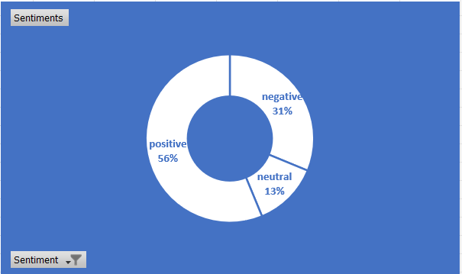
Sentiments-wise Percentage contribution

Slide 10

Key Insights:
16 content categories exist, with Animal & Science being the most popular.
Content appears in 4 formats: Photo, Video, Audio, and GIF.
Photos & Videos are the most preferred.
May has the highest number of posts across all content types.
Conclusion:
Focus on Animal, Technology, Science, Healthy Eating & Food, as they drive the most engagement.
Design campaigns tailored to these high-performing categories.
Prioritize efforts in January, May, and August, as these months see peak content activity.
Summary

Slide 11
Thank you!
ANY QUESTIONS?

